Slide 1
CCE DATA SCIENCE AND MACHINE LEARNING
WINTER 2021: February to July 2021
INTERNS: Justin Chow & Katherine Tatley
MANAGER: Kun Zan
Notes:
Intro Justin
Switch to Katherine
Katherine intro Kun

Slide 2
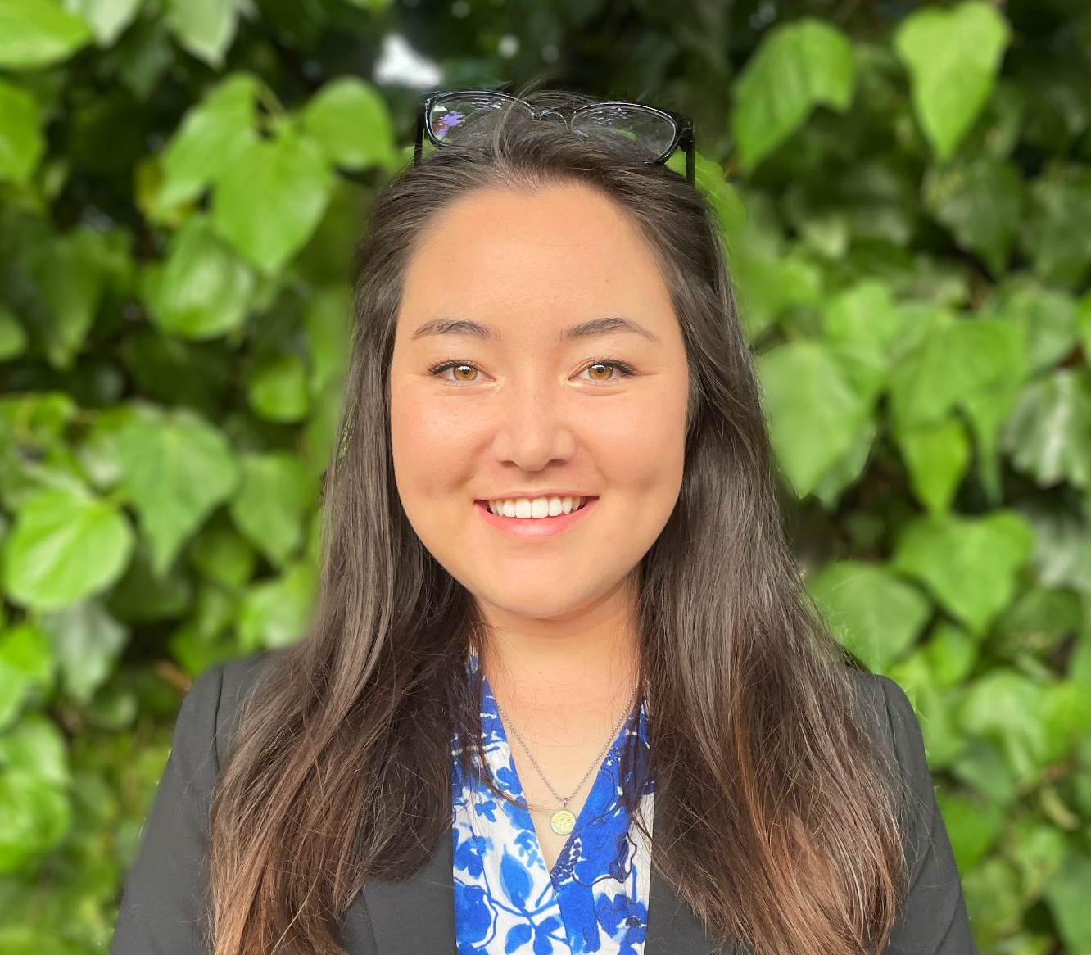
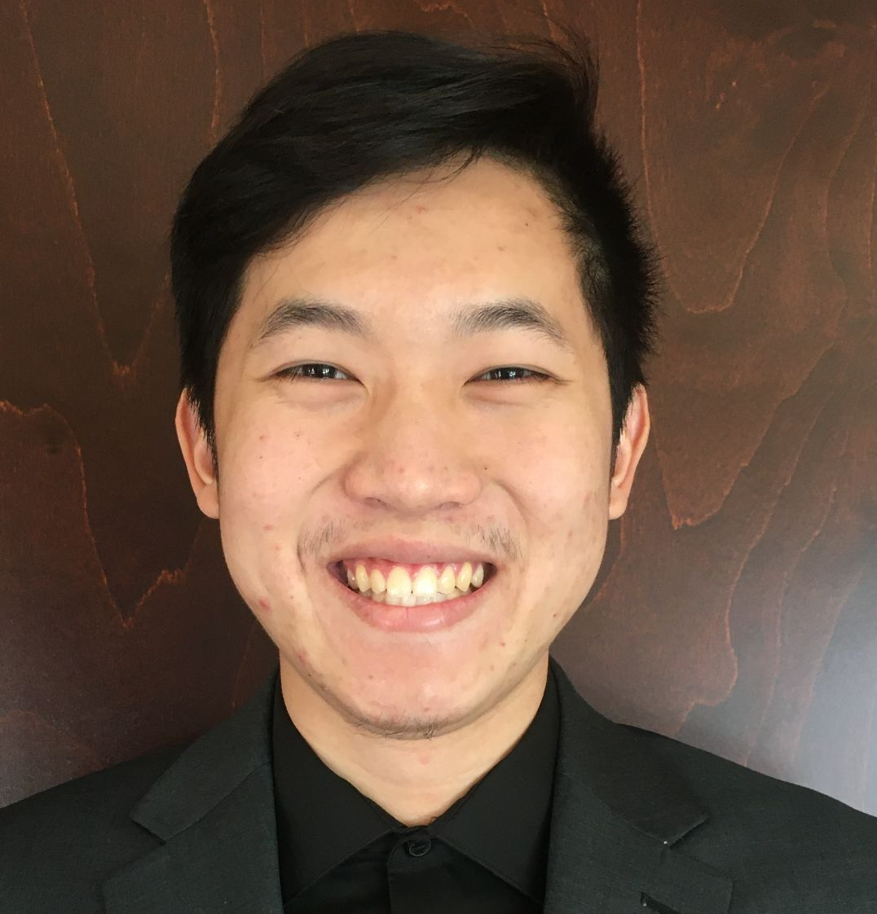
OUR BACKGROUNDS
Katherine Tatley
Bachelor’s degree in Biochemistry
Previous experience in non-profit work (BAWSI) and SMB sales
SJSU Business Analytics grad certificate
No prior Python experience
Interested in Data & Business Analytics and DS positions in Tech and Healthcare
Justin Chow
Bachelor’s degree in Economics with Concentration in Data Analytics.
UCSC Silicon Valley Extension Database and Data Analytics certificate.
Well-versed in Excel, Python, R, and PostgreSQL.
Interested in Data & Business Analytics and DS positions.

Slide 3
MANAGER GOALS FOR US
“My original purpose was to demonstrate a traditional data science project and share with both Katherine and Justin what the company will look at when approached by a possible data science candidate”. - Kun Zan

Slide 4
DS & ML INTERNSHIP ROLE FOCUS
Understand the role of Data Scientists and Machine Learning Engineers in a company
Learn how to use Python and Jupyter Notebooks
Introduction to Machine Learning applications using Kaggle
Learning how to construct a Data Science model from start to finish
Key components and techniques to streamline processes to make better, more efficient models

Slide 5
HYPOTHESIS/INITIAL QUESTIONS
01
02
03
HYPOTHESIS/ INITIAL QUESTIONS
TARGET
OUR PROCESS
Relationship between target variable and sales price
Feature engineering and selection techniques.
Find which investments were fruitful.

Slide 6

HYPOTHESIS
Hypothesis
The aim of the project is to build a machine learning model to predict the sale price of homes based on different explanatory variables describing aspects of residential houses.
Aim
Predicting house prices to identify fruitful investments based on sales price, housing features, and location; model used to determine whether the price advertised for a house is over or under-estimated.
Objectives
We aim to minimise the difference between the real price and the price estimated by our model. We will evaluate model performance using the mean squared error (mse) and the root squared of the mean squared error (rmse).

Slide 7
INITIAL QUESTIONS
Are there any specific variables that are linked to higher selling prices? What’s the most important variable?
In specific cities where most of the outcomes are similar, what causes the outliers? How do we get rid of outliers? Is there a best practice?
Which variables do not matter at all?
This notebook mentions linear modeling. Is linear modeling the best type for this data set? How would we know?
How accurately can we predict sale price from so many attributes? (This question is more so directed if we find out if there are a bunch of statistically significant variables)
How do big events affect analysis? (Ex. 2008 Housing crisis?) Do you leave it out as an outlier?

Slide 8
PROCESS
01
02
03
HYPOTHESIS/
INITIAL QUESTIONS
OUR PROCESS
TARGET
Relationship between target variable and sales price
Feature engineering and selection techniques.
Find which investments were fruitful.

Slide 9
OUR PROCESS
DATA ANALYSIS
FEATURE SELECTION
STEP 02
STEP 04
STEP 01
STEP 03
FEATURE ENGINEERING
MODEL BUILDING
Notes:
Data Analysis
Explore the numerical & categorical variables against sales price.
Feature Engineering
Pre-processing data by engineering variables.
Feature Selection
Select a group of variables, the most predictive ones.
Model Building
Build our model using engineered data & pre-selected features.

Slide 10
TARGET
01
02
03
HYPOTHESIS/
INITIAL QUESTIONS
OUR PROCESS
TARGET
Relationship between target variable and sales price
Feature engineering and selection techniques.
Find which investments were fruitful.

Slide 11
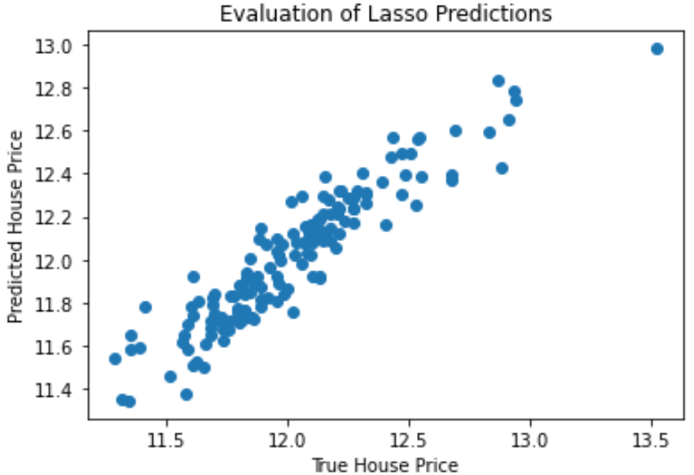
RESULTS
Our first model predicted housing prices with 83% accuracy
Answered many of our initial questions along the way
Most impactful variables
Least important variables
How many variables need to be trimmed to minimize overfitting

Slide 12
DATA SCIENCE FIELD AND FOCUSES
ALGORITHM
ANALYTICS
INFERENCE
ML Engineers
Data Scientists
BI/Business Analysts
Data Analysts
Product Analysts
Statisticians
Econometrician

Slide 13
FINAL THOUGHTS
What did we learn from our experience?
Justin
Full-scope of the DS field.
Process of developing a ML model pipeline.
Build my networking skills.
Furthered my interests in data analysis as my future career.
Digged deeper into other data science projects associated with the business world.
Katherine
Enjoyed learning about the DS field through different lenses
Great Python & ML foundation for further learning
The importance of networking
The power of mentorship

Slide 14
THANKS
Do you have any questions?
Jchow2@scu.edu
katherine.tatley@gmail.com
I Fly Young CCE
Please keep this slide for attribution

